Slide 1
Ungroup the figure, change text and color
p = 0.01
300
200
Biomass
100
0
Control
Drought
Rain
Treatment

Slide 2
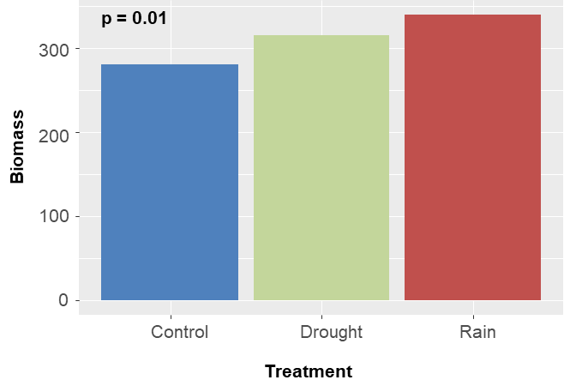
Regroup the figure, change text and color
300
Biomass
200
100
p2
Plant
p4

